Slide 1
Collision Detection
IN628 Intermediate Architectures and Algorithms
Semester 2, 2016
Session 7.1

Slide 2
Types of Collision Detection
Sprite to Sprite Collision
Sprites checking for collisions with other sprites.
Sprite to Terrain Collision
Moving sprites (e.g. player characters, NPCs) checking for collisions with objects in the tile map.
Notes:
We use different techniques for these two kinds
For the first, we need to compare the locations of the two sprites, and how we define ‘location’ we will see is important.
For the second, we need to add properties to our tiles to indicate that they represent solid objects.
We’ll do this next time

Slide 3
A priori vs. a posteriori
A priori
Compute where everyone will go
Deal with any collisions that will occur
Instantiate only legal moves
A posteriori
Move everyone
Deal with any collisions that occurred
Move anyone back who is in an illegal spot
Notes:
Two algorithms for collision detection
A priori = “before” A posteriori = “after”
We will use a combination of the two approaches – a priori for terrain and a posteriori for sprite-to-sprite

Slide 4
Number of Comparisons
Two objects, A & B
One comparison – A to B
Three objects, A, B & C
Three comparisons – AB, AC, BC
Four objects, A, B, C, & D
Six comparisons
Twenty objects – 190 comparisons
1000 objects – 499500 comparisons
Notes:
Collision detection, as we will see, is mathematically straightforward – nothing tricky involved
The more interesting technical problem is how to control the computational demands
In our little desktop game, it really makes no difference, of course, but consider the issue in an MMORPG with thousands of sprites moving around at any one game cycle, and you can see that things can get fairly demanding.
The difficulty is in the way that the number of comparisons required increases as we increase the number of sprites involved.
Doubling the number of objects on the screen roughly quadruples the number of tests you must perform.
This mathematical relationship – how many pairs can you make from a given number of objects – is an example of the operation known as ‘n choose k’. We say ‘1000 choose 2’ = 499,500.
Formula: n! / (n-k)! * k!

Slide 5
Reducing the Number of Comparisons
Game rule elimination
When a collision between two objects is not relevant to the game, don’t test for it.
Spatial elimination
When two objects are so far apart (in World Coordinates) that they can’t collide, don’t test them.
Sort all objects according to their position on one axis.
Only making comparisons between objects that are close enough to each other that they could collide.
Extra computation for maintaining sorted lists needs to be less than the extra computation required for collision detection
Notes:
To improve performance, therefore, we want to reduce the number of comparisons
There are several ways this can be done
Remember that you have to write all the code for this stuff.
Game rule elimination: Some objects can’t collide, or it doesn’t matter if they collide, so don’t check them.
For example, in Mario-type games, the various baddies often walk past each other with no effect. You can skip all those comparisons.
Or if you’re making a space-shooter where enemy missiles don’t destroy each other, there’s no need to check if they have collided.
Spatial elimination: Some objects are physically incapable of colliding, so don’t check them
Sort by location
Only compare neighbours (within some distance) in the list. Quit comparing when you get width pixels (if sorted on x axis) or height pixels (if sorted on y axis) apart.
Spatial elimination requires extra computation to sort the various objects and perform additional bookkeeping.
It is better suited for games in which a large number of objects are active at once. If a game has only a few objects, there aren't many potential collision tests to eliminate, and the added bookkeeping can exceed the gain.

Slide 6
Determining Collisions
Notes:
Given that you have decided which pairs to test, how do you programmatically determine if a collision has occurred?
Have these two objects collided?
It depends.....

Slide 7
Determining Collisions
Notes:
Have these two objects collided?
It depends
If you look at them, it appears that they have not. However, if you check for overlap of, for example, their bitmaps, you will determine that they have.

Slide 8
Determining Collisions
Fast Methods
Accurate Methods
Notes:
Algorithmically you have two choices:
Fast but inaccurate
Accurate but slow

Slide 9
Accurate Collision Detection
Pixel-based detection
For each Pixel p_{a} of Sprite1
For each Pixel p_{b} in Sprite2
If p_{a} is not Sprite1’s transparent colour and
If p_{b} is not Sprite2’s transparent colour and
They are at the same pixel location in the world
Collision = true;
Notes:
This computation is O(n2) in the number of pixels. Yuk.
But it is very accurate

Slide 10
Accurate Collision Detection
Collision Map
For each sprite, construct a grid of bits the same size as the image in pixels
Bit = 1 if the corresponding pixel is solid
Bit = 0 if the corresponding pixel is transparent
Comparison uses logical AND
Notes:
An interesting technique
A collision map can speed up this process.
Set it up in the sprite’s constructor
Here you don’t have to keep calling the GetPixel method and comparing the colours all the time, you just grab the bit
Still O(n**2) though.

Slide 11
Fast Collision Detection
Bounding Areas
Notes:
Only need to determine if the rectangles overlap
This situation will return true
The monster on the left will be annoyed
Nonetheless, this is what we will use – but we will use a slightly souped up version, as we will see in a few minutes

Slide 12
Collision Using Bounding Rectangles
Assume Sprite1 and Sprite2
Notes:
Basic approach: Compare edges (demonstrate on board or with much pointing)
Assume collision, and test the four conditions that would falsify that assumption.
If Sprite1’s Left is > Sprite2’s Right, they can’t have collided, no matter where they are on the y-axis
Similarly, if Sprite1’s Bottom is higher than Sprite2’s Top, they can’t have collided.
Same switching Sprite1 and Sprite2
You thus need to make only four comparisons:

Slide 13
Collision Using Bounding Rectangles
collided = true
if Sprite1’s BottomEdge < Sprite2’s TopEdge Collided = false
if Sprite1’s TopEdge > Sprite2’s BottomEdge Collided = false
if Sprite1’s RightEdge < Sprite2’s LeftEdge Collided = false
if Sprite1’s LeftEdge > Sprite2’s RightEdge Collided = false
return collided
Notes:
This is a common boolean pattern: Start in the more probable state. Check the conditions that falsify it. Return the outcome.
For readable code, get all those bottom edges and right edges into variables before doing the comparisons, don’t do the height and width additions inside the booleans, it will be too busy.
Yes, there are built-in methods in .NET you could use, but you should write your own so that you know how if you are ever working in a language that doesn’t have them.

Slide 14
Whose Method Is It?
bool Sprite::CollidedWithMe(Sprite^ otherGuy)
Notes:
This should be a method of Sprite, since he has the most direct access to his location and dimensions
Because there are two sprites involved, you will need to call the method on one instance and pass the other instance in.
Pass your Sprite the other guy and ask him if he and the other guy have collided.

Slide 15
What About Sprite Lists?
Sprite^ SpriteList::checkCollisions(Sprite^ otherGuy)
Traverse the list, passing otherGuy to the collidedWithMe method of each Sprite in the list
Return the first Sprite hit, or null if there are no collisions
Notes:
What about when we have a list of sprites to compare?
For example, we might want to compare the player character against all the enemies
It is easier to pass one guy into the list than to query the list for each element and pass it to the one guy
Yes, this will not be perfect if there are two simultaneous collisions
If it’s critical, you could write the code to build and return a linked list of collidedWiths
The approach illustrated here is acceptable for our purposes.

Slide 16
What About List vs List?
Discuss...
Notes:
When comparing non-player sprite lists SL1 and SL2, pass one entire list (say SL1) to the other list (in this case SL2), and let him handle the looping.

Slide 17
Improving Bounding Rectangle Detection
Notes:
Most sprites have a large rectangular border of transparent pixels.
These will cause false alarms in a simple collision detection algorithm.
Improve them by comparing, not the image borders, but some proportional reduction (10% to 30% usually, depending on your sprites).
Each sprite needs its own reduction term depending on its images, so you will need to add it as a class property.
Don’t bring it in too much, or you’ll miss
Make the proportional reduction a parameter to the collide method (left as an exercise)
Experiment to find the correct proportional reduction.

Slide 18
Combining Approaches
Use bounding Rectangles to determine image file overlap
Use pixel comparisons to determine real overlap if step 1 indicates a collision.
Notes:
As you are trying to balance computational load and accuracy, you may consider an intermediate approach
For the actual requirements of this class, bounding rectangle with reduction is good enough.

Slide 19
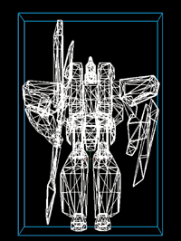
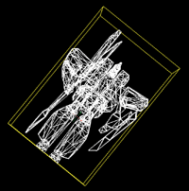
3D Maths -- Complicated
Requires a bounding volume
Complicated because objects may be in different planes.
Complicated because objects may be rotated
Notes:
There’s a lot of maths here...

Slide 20
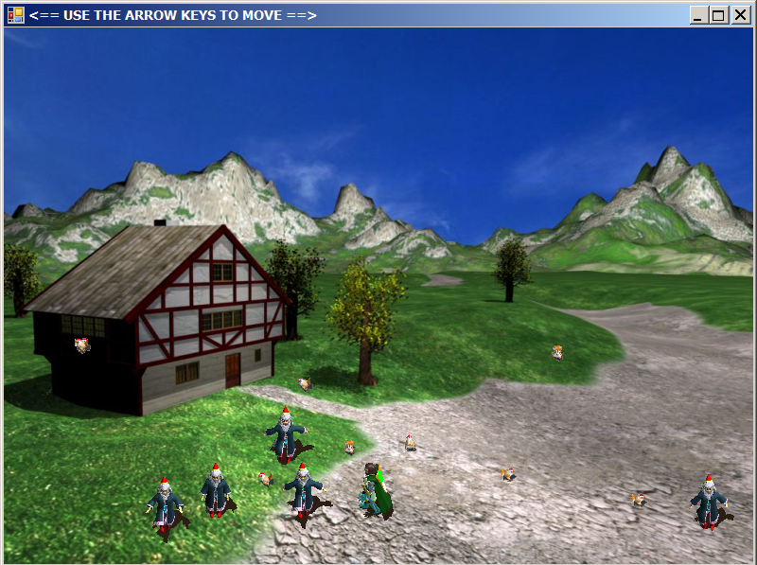
Practical 7.1
Notes:
Build an application with a player character under keyboard control, and a list of NPC sprites.
Program some observable behaviour on collision.
If you have already implemented sprite-to-sprite collision detection, refactor your architecture to remove any coupling or lack-of-cohesion cohesion problems.
DO NOT JUST STUFF THE COLLISION DETECTION CODE INTO THE MOVE. Use the architecture as described. Remember “it works” is no longer enough. It also has to be right.

